Slide 1
Berkshire

Slide 2
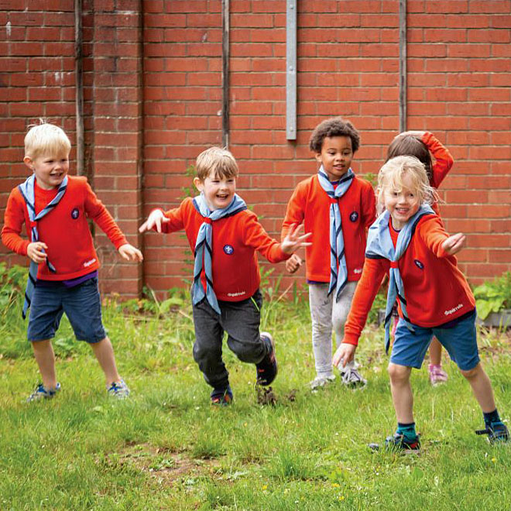
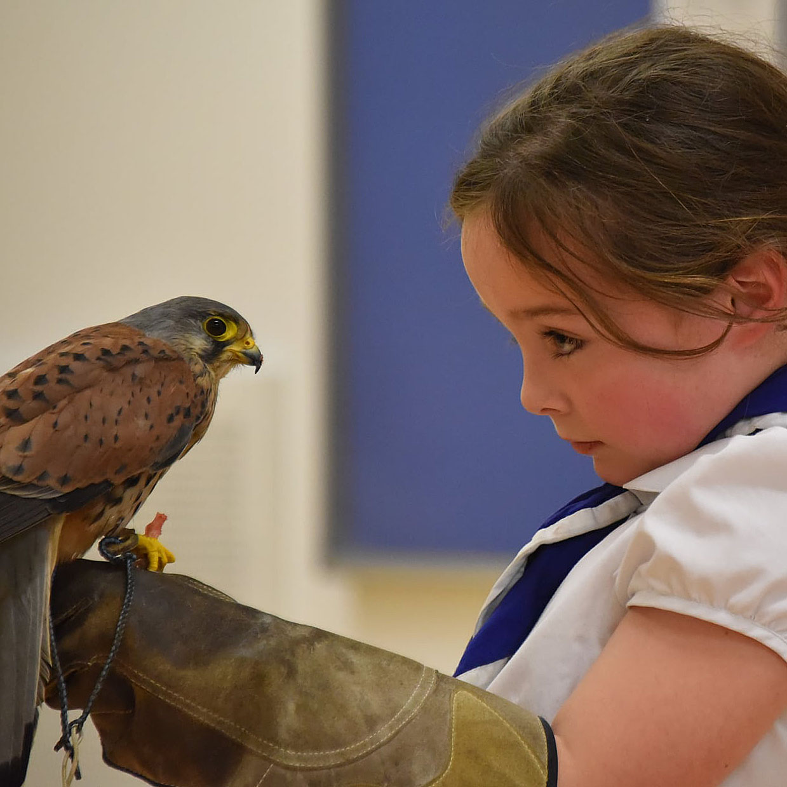
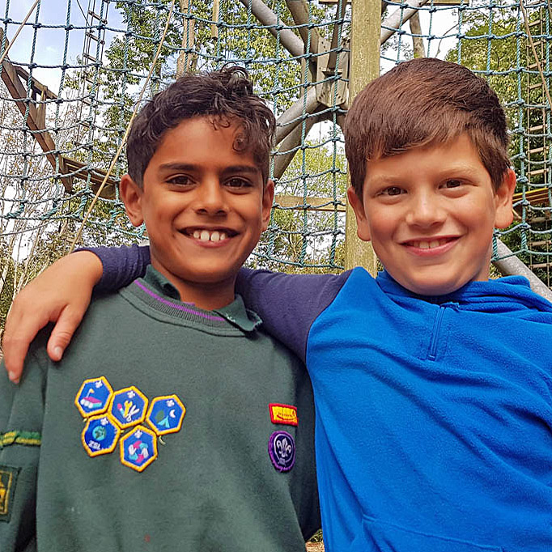
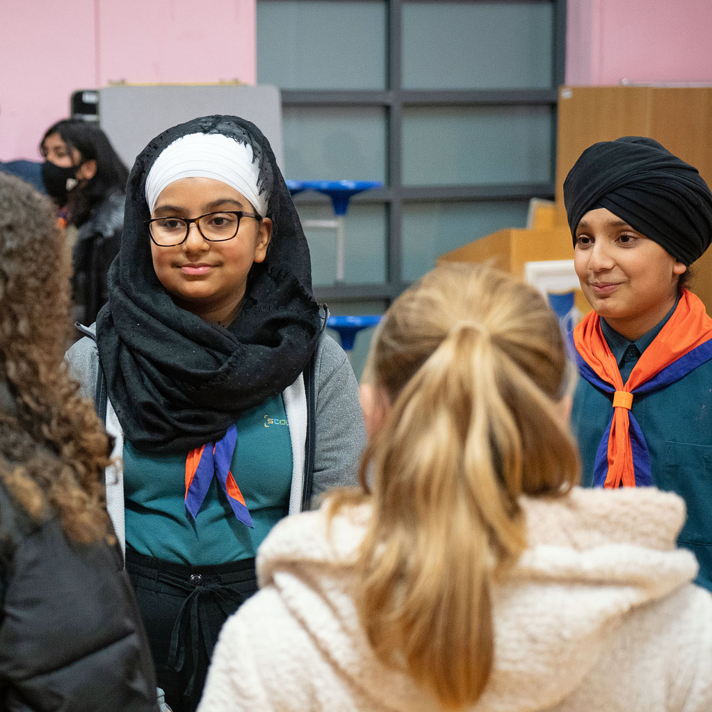
Trustee Workshop
Transformation
Pete Jeffreys
Deputy County Commissioner

Slide 3
The Volunteer Experience Transformation
A warmer welcome for everyone
A more positive learning experience
Positive volunteering everyday
A more supportive digital experience
Notes:
Rob

Slide 4
What’s changing?
From | To
Unclear expectations of volunteers Individual, inflexible fixed roles A small number of people with lots of responsibility (and stress) Feels like work | Clearer roles Volunteers working in teams on tasks Teams have a clear and distinct purpose Individuals contributing in a way that matches their skills, interests and availability Flexible volunteering the norm
I receive regular support in a way that is safe, open, and honest. I feel respected and seen
What might new volunteers say
We don’t feel very supported by the District, and it scares me, because I quite often worry that I’m going to melt and say ‘I can’t do this anymore’
- GSL/Scout Section Leader
Notes:
Rob

Slide 5
How we talk about teams and roles
Every team has a team leader (or leaders) and team members
Role titles will change
Named roles retained where they serve a clear purpose
Notes:
Rob

Slide 6
Section & Group Structure
Sections
Team Leader(s)
Team Member
Team Member
Section Team
Group
Young Leader
Team Member
Young Leader
Group Leadership Team
Trustee Board

Slide 7
District & County Structure
Young Leaders
Explorers
Trustee Board
Leadership Team
14–24 Team
Network
Trustee Board
Leadership Team
District
County
Volunteering Development Team
Groups
Volunteering Development Team
Districts
Support Team
Programme Team
Programme Team
Support Team

Slide 8
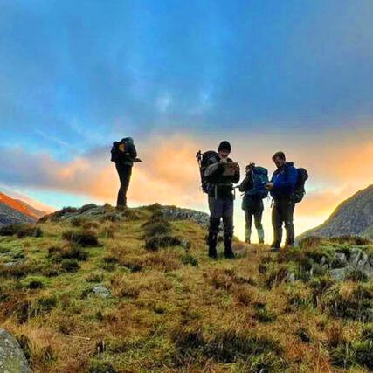
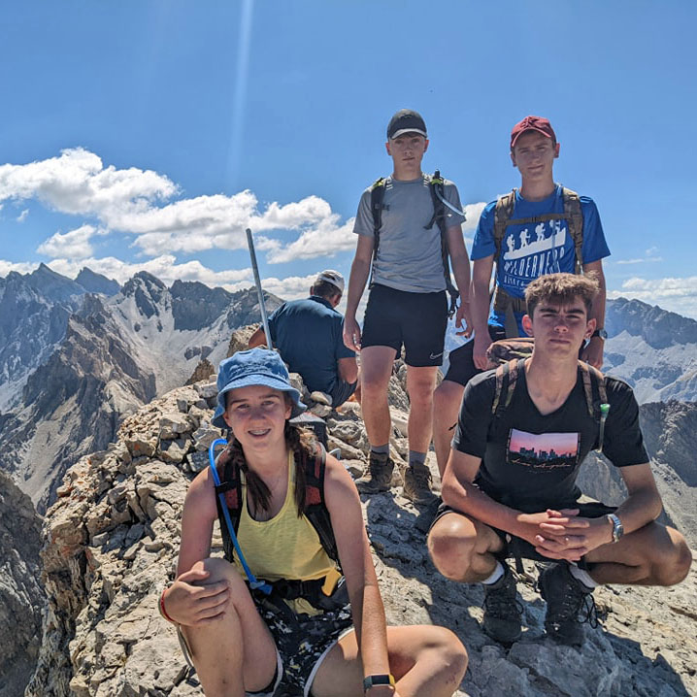
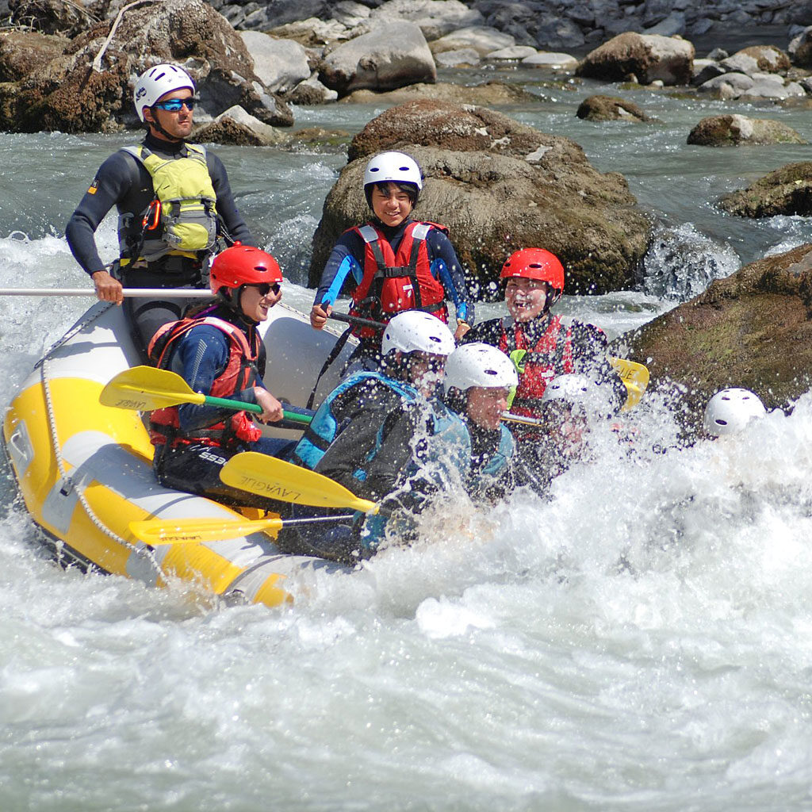
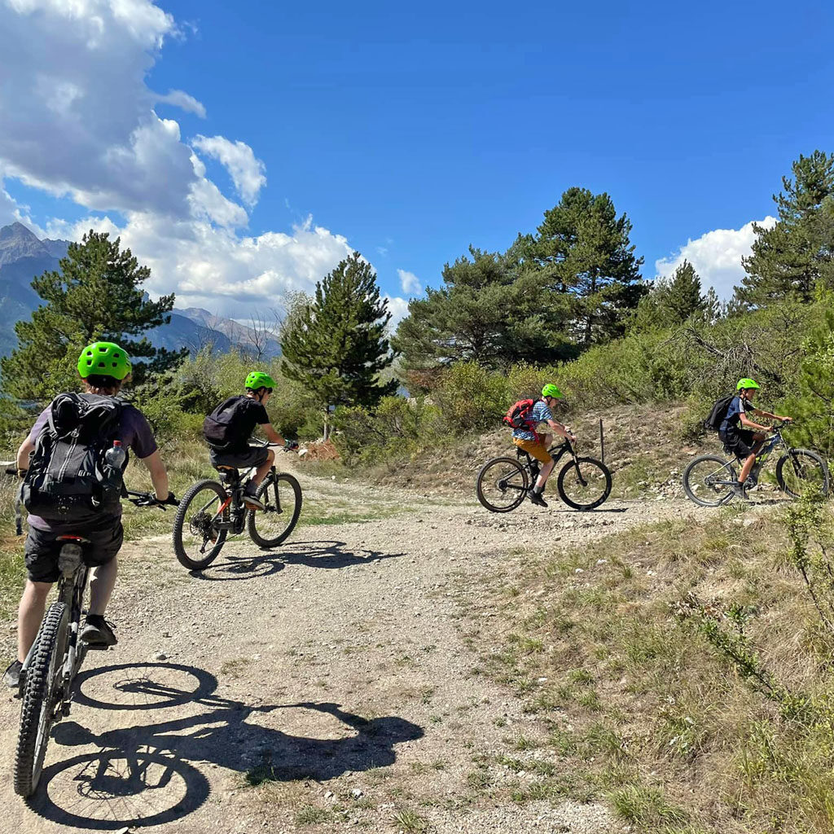
Trustee Workshop
Trustee Boards
Renaming the team and its members
Trusteeship/governance vs management/support
Operational matters
AAC to Volunteering Development Teams
Management of money, resources, etc, into support functions
Resizing Trustee Boards

Slide 9
Trustee Workshop
Getting ready . . .
Refresh agenda and papers to focus on governance and trusteeship
Prepare conversations to resize at the next AGM
Prepare how the support functions will run
When recruiting, consider where people will fit

Slide 10
Berkshire

