Slide 1
Berkshire

Slide 2
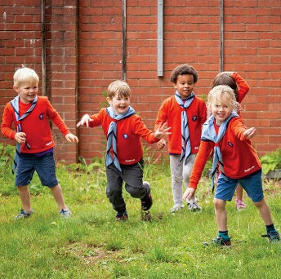
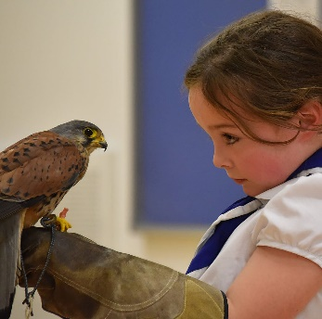
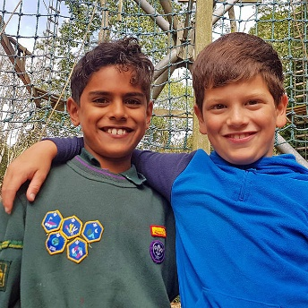
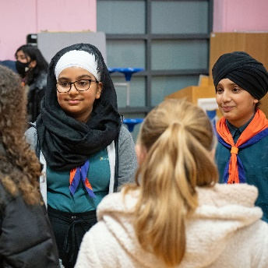
Trustee Workshop
Trustee recruitment
Becky Eytle
Volunteer Development Officer (VDO)

Slide 3
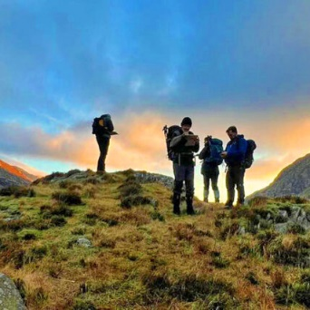
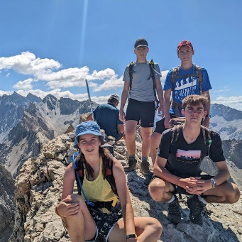
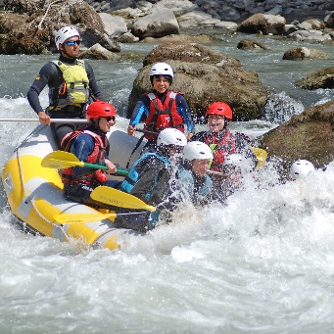
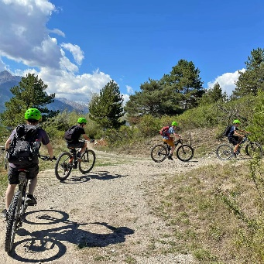
Trustee Workshop
Why recruit trustees?
To provide a required skill
To fill a role
To share the workload
For diversity of perspective

Slide 4
Trustee Workshop
Why be a trustee?
Build your CV
Share skills
Gain new skills and experience
Flexible
Community
Give back

Slide 5
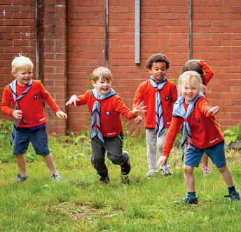
Trustee Workshop
Preparation for recruiting
What skills?
Role description? It is recruitment friendly?
How advertise?
What is the recruitment process?
Induction?

Slide 6
Trustee Workshop
Attracting volunteers:
Section teams
Get in front of parents
Local businesses/ universities/ networks
Young people leaving explorers
Local advertising – social media, LinkedIn, posters
Ask F2F, emphasise benefits and match skill set to need

Slide 7
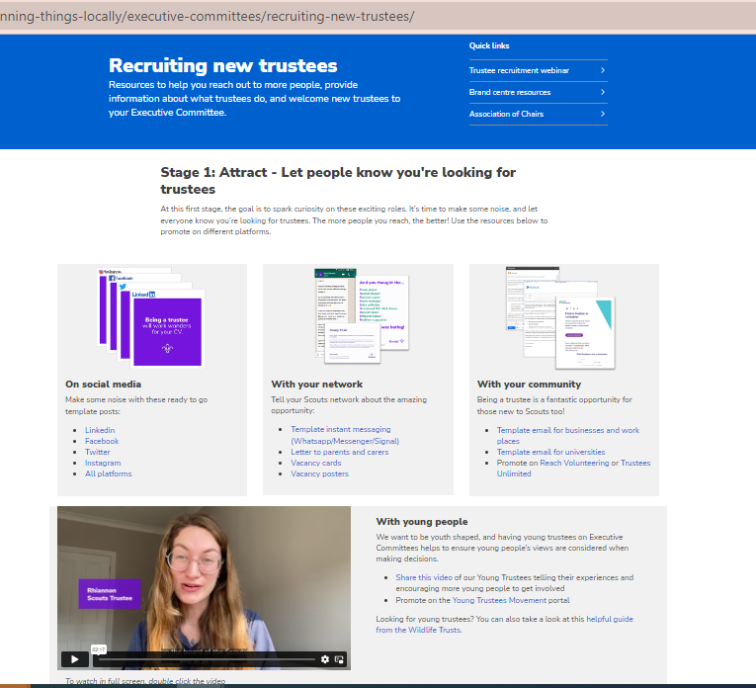
Trustee Workshop
Recruitment Resources
Scouts.org.uk
Scoutsbrand.org.uk

Slide 8
Trustee Workshop
External resources
Honorary Treasurers Forum
Getting on Board
NVCO
Reach Volunteering
The Institute of Chartered Accountants (ICAEW)
Bar in the Community for legally qualified trustees.
The Media Trust for communications volunteers.

Slide 9
Trustee Workshop
Discussion: 15 mins
Skills/ tasks you need
Recruitment plan – What would you do to recruit for the above skills/ tasks?

Slide 10
Trustee Workshop
Diversity: age, gender, ethnicity, religion, disability, sexual orientation, education, and national origin.
“Board diversity, in the widest sense, is important because it creates more balanced decision making. Where appropriate, this includes and centres the communities and people the charity serves. This increases the charity’s legitimacy and impact. Equality and diversity are only effective and sustainable if the board works to be inclusive, ensuring that all trustees are welcomed, valued and able to contribute.”

Slide 11
Trustee Workshop
Encourage diversity
Culture
Role Description/ advert – welcoming to diversity
Meeting times – work/ families/ remote option
Induction – buddy/ mentor
Venue

Slide 12
Trustee Workshop
Diversity resources
Young Trustee Movement
NCVO
Wildlife Trust
Getting on Board
Action for Trustee Racial Diversity

Slide 13
Trustee Workshop
Discussion
Does your trustee board reflect your community?
What changes could you make to encourage greater diversity in your board.

Slide 14
Berkshire

