Slide 1
Berkshire

Slide 2
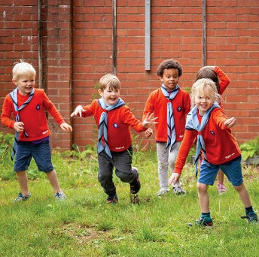
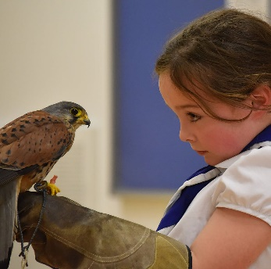
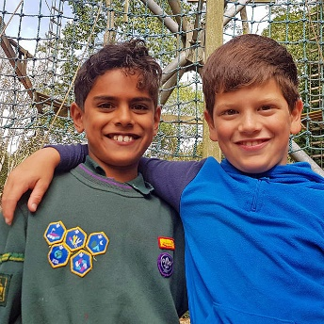
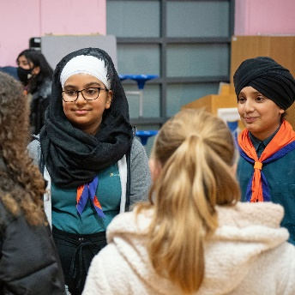
Trustee Workshop
Safety
Ian May
ACC (International) & Safety ASU
Notes:
I am also a Trustee on the County and Reading Central Exec
28 years as a School Governor, Trustee and now Member for a multiple academy
Experience around the room? School Gove/Trustee other similar roles outside scouting?

Slide 3
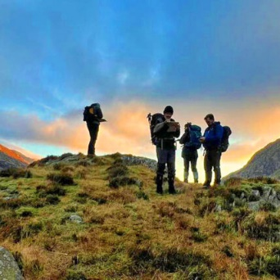
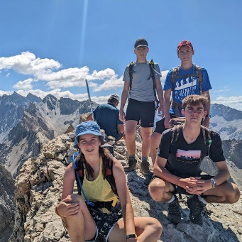
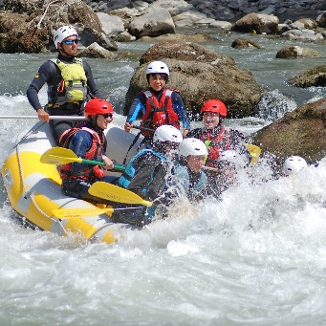
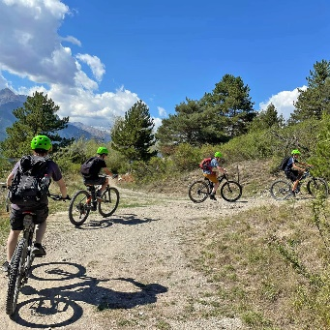
Trustee Workshop
Some key considerations:
Creating and maintaining a safety culture
throughout the Group/District
Staying Safe - POR
Safety on the agenda
Asking the right questions
Recording and acting on incidents & ‘near misses’
Notes:
A FEW SLIDES THAT SHOULD, HOPEFULLY, START DISCUSSION GOING WHHC WILL COVER THE CONTENT WITHOUT PROMTS FROM THE SCREEN ☺
Check that the appointment process is being followed
Ensure good provision of training for leaders and managers to encourage safe Scouting
Review incidents and accidents
Support statutory compliance for campsites & premises
Discuss the need to bring in outside professional/competent help if necessary
The County Safety ASU can help with guidance and support - Contact via the County Office

Slide 4
Trustee Workshop
Staying Safe
It's the responsibility of all those involved in Scouting to seek, so far as is reasonably practicable, to ensure that all activities are conducted in a safe manner without risk to the health of the participants.
It is not the role of the Trustees to do this but to
ensure that it is being done and monitor its effectiveness
Notes:
The safety of both young people and adults is important. A large part of this is about being organised, asking the right questions and doing things that will help safety without taking away a sense of adventure appropriate to the age group. This is a checklist of common hazards that will help you assess some of the risks you are likely to have and put suitable controls in place. Additional support can be found at scouts.org.uk/safety or alternatively, speak to your Executive Committee Chair or line manager, Safety Adviser or others locally.
Published September 2021)
This is aimed to help all members of an Executive Committee to fulfil their roles and responsibilities in managing and supporting safety in Scouts.

Slide 5
Trustee Workshop
Staying Safe - Your responsibilities within the Safety Policy
POR rule 2.5 explains the responsibilities different members have within the Safety policy. Remember there are some responsibilities that all adults hold and others specific to your role as a Trustee on an Executive Committee.
Follow the policy, and engage and consult with members on day-to-day health and safety conditions
Safety is on the agenda at all meetings
Take responsibility for making sure that these requirements are met for every premises or location operated by a Scouting concern.
Notes:
All members of a Scouts Executive Committee must read the Safety Policy (POR Chapter 2) to understand their specific responsibilities within it.
https://www.scouts.org.uk/por/2-key-policies/

Slide 6
Trustee Workshop
Safety on the Agenda
Make safety an agenda item at all meetings
Relevant safety information is communicated effectively to volunteers, contractors, premises users and the Executive Committee.
Safety item topic: recent updates, key priorities, compliance, premises management, incidents and concerns.
Review the current picture and also plan for improvements.
Notes:
DO YOU DO THIS?

Slide 7
Trustee Workshop
Managing safety locally
People
Have all adults (including Executive Committee members) undertaken the relevant training for their role
Support and resources are being made available for necessary training
Is the appointment process is being followed
Assess and use external help in areas that lie outside of the Executive’s expertise
Notes:
People
Check all adults (including leaders, managers, supporters and Executive Committee members) have undertaken the relevant training for their role. This includes ongoing safety training. You can do this using compliance and training reports, which can be provided by the relevant Commissioner.
Make sure that support and resources are being made available for necessary training – are there any barriers to adults completing training, for example, cost or location? If so, make sure these are discussed and addressed.
Check that the appointment process is being followed – if it is, then line managers will be explaining the Safety policy to new adults, and the approval meeting (for those who require it) will make sure that adults understand their role and responsibilities. More generally, the appointment process will make sure that only suitable adults are appointed to roles that they can carry out.
Assess and use external help in areas that lie outside of the Executive’s expertise, for example, asking the local fire officer for assistance with regard to fire safety, fire risk assessment, storage of gas and so on. Use competent workers, for example, gas safe heating engineers.

Slide 8
Trustee Workshop
Managing safety locally
Premises under your management
Appropriate risk assessments are in place, including premises, and reviewed regularly
Is there an appropriate person responsible for premises
Adequate controls are in place
It is not the role of the Trustees to do this but to
ensure that it is being done and monitor its effectiveness
Notes:
Premises under your management (covered in separate session)
Carry out appropriate risk assessments and effectively communicate controls to all users of the premises.
Make sure there’s an appropriate person responsible for premises. This could be someone appointed from your Executive Committee to make sure that the relevant information and updates are provided to the committee regularly.
Make sure controls are in place, and are coordinated and monitored.
Make sure that all repairs are carried out in a safe and timely manner.
Make sure premises risk assessments are in place, documented, communicated and reviewed at least annually.

Slide 9
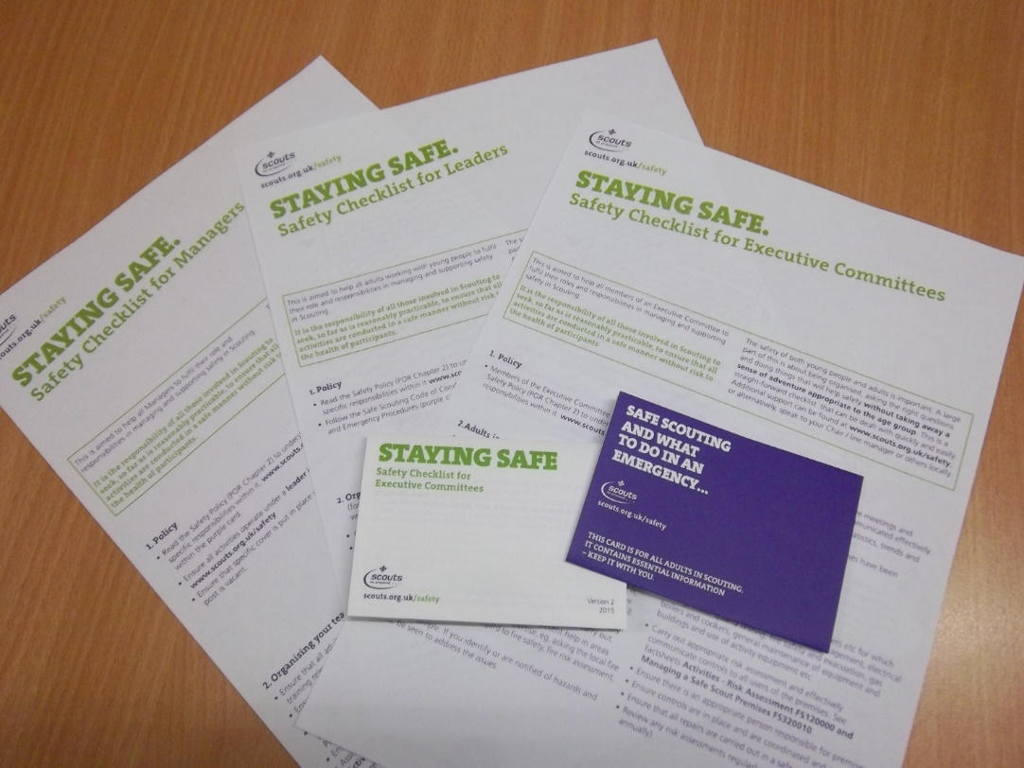
Trustee Workshop
Staying Safe –
Safety checklist for Executive Committees
Notes:
The Staying Safe - Safety Checklist for Executive Committee is a pocket sized checklist aimed to help all members of an Executive Committee to fulfil their roles and responsibilities in managing and supporting safety in Scouting.
The safety of both young people and adults in Scouting is important. A large part of this is about being organised, asking the right questions and doing things that will help safety without taking away a sense of adventure appropriate to the age group. This is a straight-forward checklist that can be dealt with quickly and easily.
It is the responsibility of all those involved in Scouting to seek, so far as is reasonably practicable, to ensure that all activities are conducted in a safe manner without risk to the health of the participants.
https://www.scouts.org.uk/volunteers/staying-safe-and-safeguarding/safe-scouting-cards/staying-safe-safety-checklist/staying-safe-executive-committees/

Slide 10
Trustee Workshop
Recording and acting on incidents & ‘near misses’
Incident – reporting incidents where injuries occur
Near Miss - important to log and track incidents which could have resulted in significant injury or impact or could have been much worse given a few minor changes to the situation.
https://www.scouts.org.uk/volunteers/staying-safe-and-safeguarding/incidents-and-illness/emergencies-and-reporting/
Notes:
Chapter 7 of Policy, Organisation and Rules (POR) lays out the procedures to be followed in the event of an emergency involving a member of The Scout Association.
Purple Card - This contains essential Information to help adults in scouting to plan safe activities and the necessary prompts to aid you in the event of an accident.

Slide 11
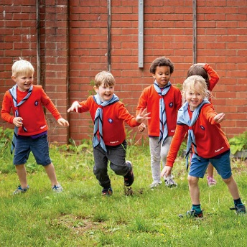
Trustee Workshop
Some key considerations for discussions:
WHAT IS MEANT BY THESE?
DO YOU KNOW IF AND HOW THIS HAPPENS IN YOUR GROUP/DISTRICT?
Risk management/Risk Register
Risk Assessments (keep it simple)
Safeguarding
High risk events finance; safety; reputation
Safety training (mandatory)
Notes:
WHAT IS MEANT BY THESE? DO YOU KNOW IF THIS HAPPENS IN YOUR GROUP/DISTRICT?
Risk management- examples of Risk Register (Financial/safeguarding/buildings/campsite/vehicles/policies)
Risk Assessments (keep it simple)
Safeguarding – reporting/mandatory training
High risk events - finance; safety; reputation – International trip/large group or district camp – who is financially liable
Safety training (obligatory)

Slide 12
Trustee Workshop
Discussion
Notes:
THANKS, QUESTIONS, HOPE THIS HAS MADE YOU THINK ABOUT YOUR ROLE IN SCOUTING
ENJOY THE REST OF THE DAY

Slide 13
Berkshire

